Slide 1
Coursera Capstone Project: Mapping Bars and Pizza Places in Easton, PA
Steve Ruhmel

Slide 2
Introduction & Business Problem
The State Theatre in Easton, PA is a popular venue in the region, attracting patrons from far distances who are not familiar with the city.
The theatre wants to provide patrons with an interactive map of bars and pizza places near the venue so they have recommendations on where to get food or drinks before/after an event.

Slide 3
Data
All data will be fetched from Foursquare’s API.
Data is filtered within the query itself to only return bars and pizza places.
Most important returned fields: venue name, category, longitude, latitude.
The venues are plotted on a folium map, color coded by type.

Slide 4
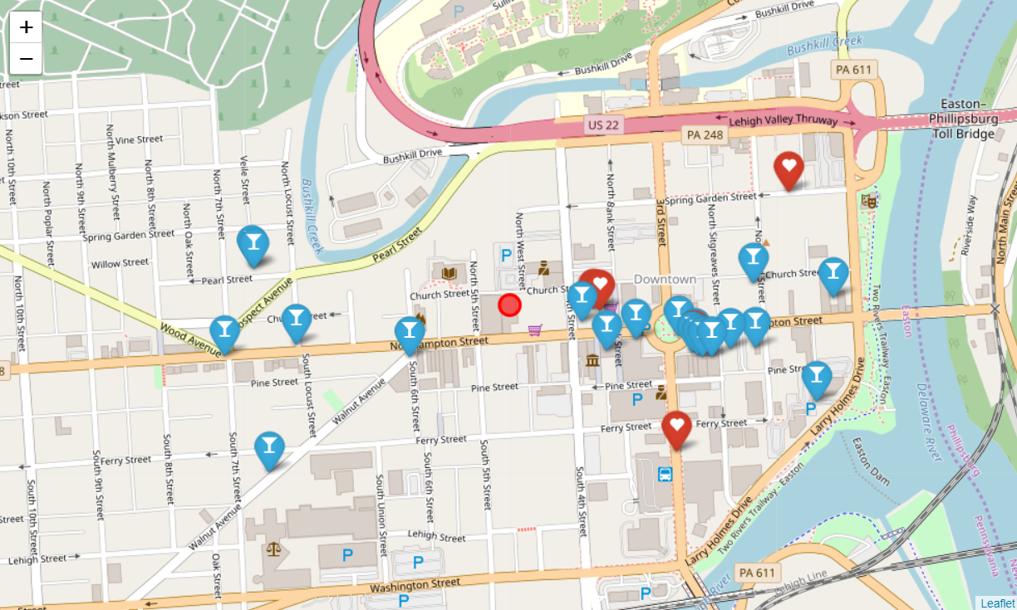
Map
Red marker/heart = pizza place
Blue marker/martini glass = bar
Red dot = The State Theatre

Slide 5
Methodology
Search Google Maps to confirm there are adequate venues of these 2 categories in the area; reconfirm business need.
Construct Foursquare API call retrieve JSON of all applicable venues. 26 venues were returned.
Returned fields: venue name, categories, address, country code, city, country, cross street, distance from center point (the theatre), formatted address, latitude, longitude, postal code, state, and venue ID
Wrangle data and convert to friendly dataframe.
Create folium map; iterate through data to populate map.

Slide 6
Results
The map is appropriately zoomed and displays all 26 venues with labeled markers.
Only pizza places and bars are displayed; all other venue categories are hidden.
The folium map can be easily zoomed and panned by the user.

Slide 7
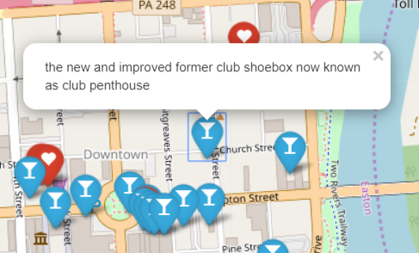
Discussion
The Foursquare data is complete, but includes user-generated venues which do not exist. See example.
Future versions of this map should manually sort through the data and remove such fake venues.

Slide 8
Conclusion
This project provided patrons of the State Theatre with a custom map that shows all nearby bars and pizza places.
Foursquare’s API provided access to all necessary data to create this map, however it also returned some fake, user-created venues.
Future versions should remove fake venues and also create a printer-friendly version of the map.

